Slide 1
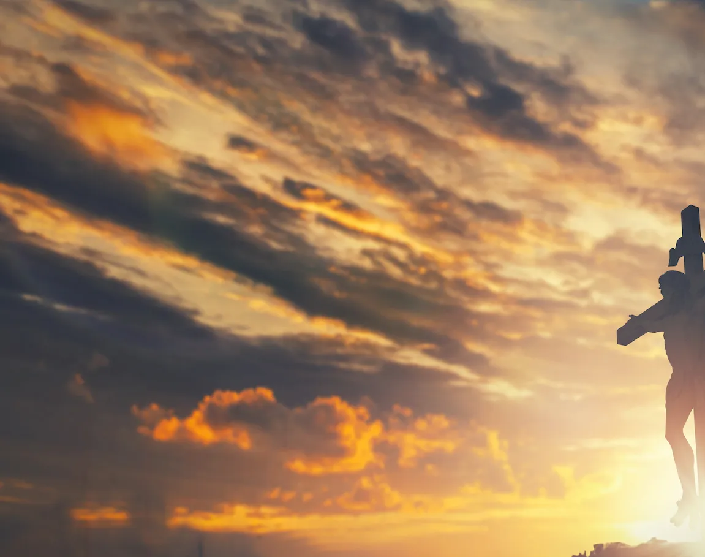
Above All

Slide 2
CAPO 3rd
G A D
Above all powers, above all Kings
G A D
Above all nature, and all created things
Bm A G D
Above all wisdom, and all the ways of man
Em A D
You were here before the world began

Slide 3
G A D
Above all kingdoms, above all thrones
G A D
Above all wonders this world has ever known
Bm A G D
Above all wealth and treasures of the earth
Em G F#
There's no way to measure what You're worth

Slide 4
D Em A D
Crucified, laid behind a stone
D Em A D
You lived to die, rejected and alone
Bm A G D
Like a rose, trampled on the ground
Em D G A D
You took the fall, and thought of me Above all

Slide 5
G A D
Above all powers, above all Kings
G A D
Above all nature, and all created things
Bm A G D
Above all wisdom, and all the ways of man
Em A D
You were here before the world began

Slide 6
G A D
Above all kingdoms, above all thrones
G A D
Above all wonders this world has ever known
Bm A G D
Above all wealth and treasures of the earth
Em G F#
There's no way to measure what You're worth

Slide 7
D Em A D
Crucified, laid behind a stone
D Em A D
You lived to die, rejected and alone
Bm A G D
Like a rose, trampled on the ground
Em D G A D
You took the fall, and thought of me Above all
Play x2

Slide 8
Bm A G D
Like a rose, trampled on the ground
Em D G A D
You took the fall, and thought of me Above all
END

